Slide 1
Reading Data from the Web
Part II: Web Scraping

Slide 2
Two major paths
There’s data included as content on a webpage, and you want to “scrape” those data
Table from Wikipedia
Reviews from Amazon
Cast and characters on IMDB
There’s a dedicated server holding data in a relatively usable form, and you want to “ask” for those data
Colorado information marketplace
Data.gov
Star Wars API

Slide 3
https://github.com/ropensci/user2016-tutorial
Garrett Grolemund, “Extracting data from the web”

Slide 4
Your turn: find the source code for the Mean Girls IMBD page
Goto:
Safari
Preferences
Advanced, check “Show Develop menu” in menu bar
Develop
Show page source
Goto:
View
Developer
View Source
Right click on page
Click view source
Goto:
Firefox
Web Developer
Page Source

Slide 5
https://github.com/ropensci/user2016-tutorial
Garrett Grolemund, “Extracting data from the web”

Slide 6
Your turn
Navigate to the IMDB page for Mean Girls and open the source code
Locate the piece of HTML that inserts Lindsay Lohan into the Cast section.
Which HTML tag(s) surrounds her name?

Slide 7
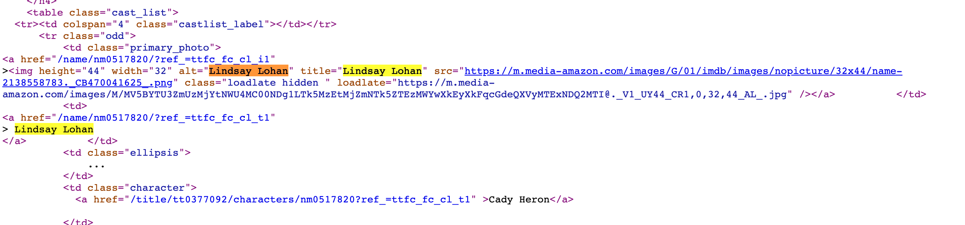
All the information you see on the page is embedded here

Slide 8
Cascading Style Sheets (CSS)
+

Slide 9
CSS Selectors
CSS is a framework for customizing the appearance of elements in a web page
Because CSS controls appearance, CSS identifiers appear throughout HTML code
HTML elements you care about frequently have unique identifiers
Extracting what you want from HTML is often a question of specifying an appropriate CSS Selector

Slide 10
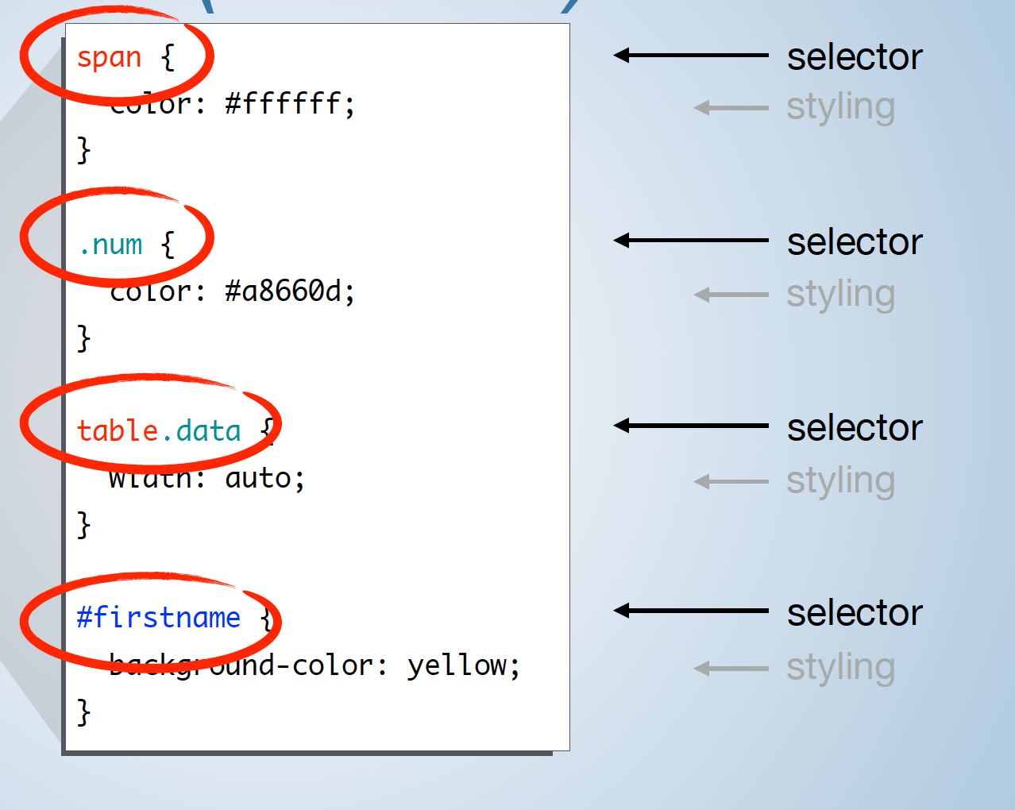
CSS (Review)

Slide 11
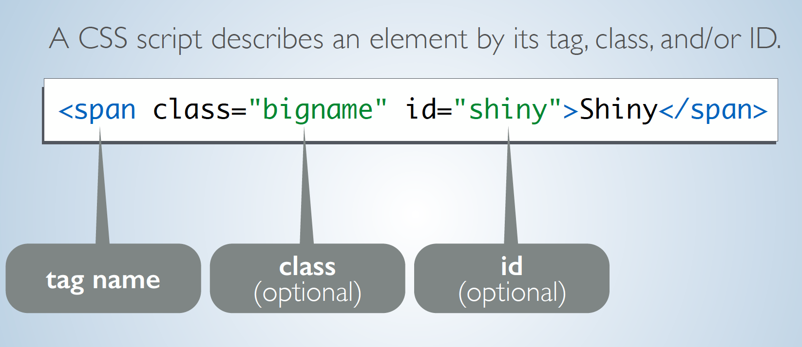
CSS (Review)

Slide 12

Find the CSS Selector
Selector Gadget is the most common tool for finding the right CSS selector on a page
In a browser, go to the page you care about
Launch the Selector Gadget
Click on things you want
Unclick things you don’t
Iterate until only what you want is highlighted
Copy the CSS Selector
Inspector Gadget

Slide 13
Using Selector Gadget
You’ll need Google Chrome
Install at https://selectorgadget.com/
Select “Chrome Extension”

Slide 14

Scraping data into R
rvest facilitates web scraping
Workflow is:
Download HTML using read_html()
Extract nodes using html_nodes() and your CSS Selector
Extract content from nodes using html_text(), html_table(), etc

Slide 15
Scaping data can be hard
Data from the web is often messy
It will frequently take a lot of work to figure it out
How to get what you want
How to tidy it once you have it

